Slide 1
Project on Regression Modeling
Abhinay Kalavakuri
Data Science

Slide 2
Brief on regression modeling
Regression modeling is a statistical approach to quantify the relationship between a dependent variable and independent variables.
Steps in regression modelling include data pre-processing, feature selection, model fitting and model evaluation
Model evaluation is done using the metrics like mean squared error or R- squared to assess how well the model predicts the dependent variable.
It provides insights into relationships, helps understand the impact of the features on target variable.

Slide 3
Objective of this presentation
To demonstrate the development and performance of a regression model for profit prediction.
To highlight the potential benefits of utilizing a regression model for profit prediction for companies.

Slide 4
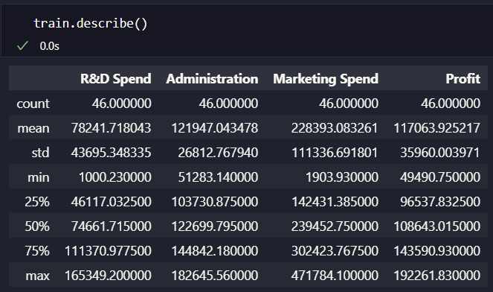
Dataset overview
The dataset contains over 50 rows and 4 columns (R&D Spend, Administration, Marketing Spend as feature columns and Profit as target column).
There is an outlier in the dataset and invalid points like Zeros in the dataset.
After removing outlier and zero values points

Slide 5
Data Preprocessing Techniques
The invalid points like zeroes and outliers are removed from the data.
The dataset is normalized for improved convergence and equal treatment of features.
StandardScalar is used in this project for normalizing data.
The dataset is then split into training and testing datasets (70%/30%)

Slide 6
List of Existing Models that are trained on this dataset
Linear Regression
SGD Regression
Ridge Regression
Lasso Regression
Decision Tress Regression
Random Forest Regressor

Slide 7
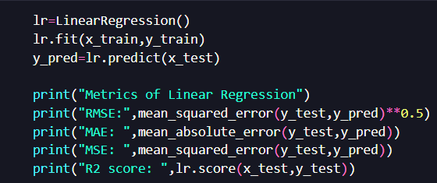
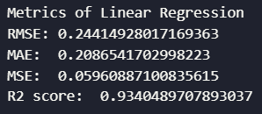
Linear Regression
Linear Regression model is imported from sklearn.linear_model
It was trained on x_train, y_train using the code snippet and the metrics are as follows on the testing dataset.

Slide 8
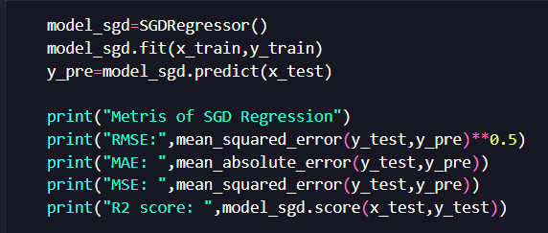
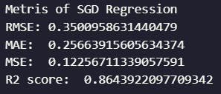
Stochastic Gradient Descent Regression
SGDRegressor is imported from sklearn.linear_model.
It was trained on x_train, y_train using the code snippet and the metrics are as follows on the testing dataset.

Slide 9
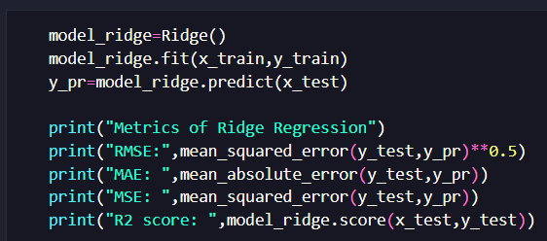
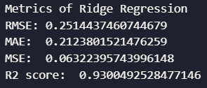
Ridge Regression
Ridge is imported from sklearn.linear_model
It was trained on x_train, y_train using the code snippet and the metrics are as follows on the testing dataset.

Slide 10
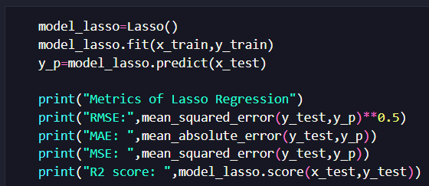
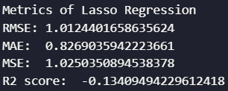
Lasso Regression
Lasso is imported from sklearn.linear_model
It was trained on x_train, y_train using the code snippet and the metrics are as follows on the testing dataset.

Slide 11
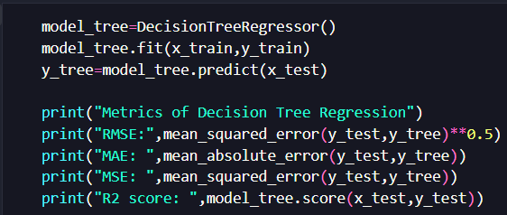
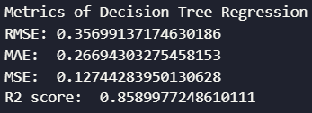
Decision Tree Regression
DecisionTreeRegressor is imported from sklearn.tree
It was trained on x_train, y_train using the code snippet and the metrics are as follows on the testing dataset.

Slide 12
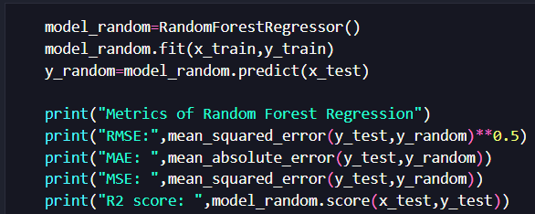
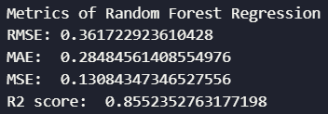
Random Forest Regression
RandomForestRegressor is imported from sklearn.ensemble
It was trained on x_train, y_train using the code snippet and the metrics are as follows on the testing dataset.

Slide 13
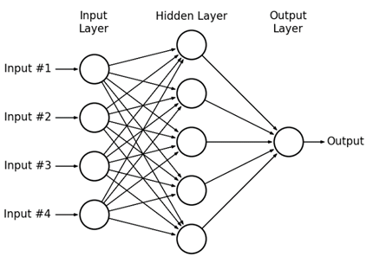
Proposed Model with architecture
By using Neural Networks, we can customize the architecture, no of hidden layers and the number of neurons in each layer.
By customizing, neural networks can learn to approximate the underlying function mapping the input to the output.

Slide 14
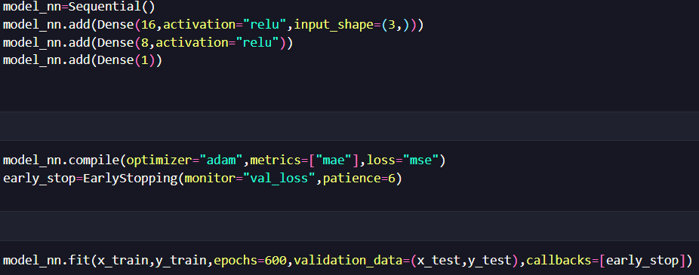
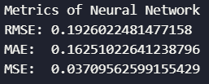
Proposed Model with architecture
The following architecture is implemented by a Sequential Model and Dense layers are used that are imported from keras.
Adam optimizer and EarlyStopping callbacks method of Regularization is used to prevent the model from overfitting and is trained over 600 epochs and the metrics were calculated.

Slide 15
Conclusion
By comparing the existing models, Linear Regression Model performed well when compared to other models.
Neural Networks can be customized to perform better than the traditional models.
Among the different architectures, (16,8,1) gave better results.

